Slide 1
Rate A Club
Brian Pigford, Chad Lenz, Dylan Weigartz, Emmanuel Maku, Joseph Hays, Max Cardillo, Nicholas Myers

Slide 2
Description and Purpose
Description:
A website that is used to rate and review college clubs. It is also used to provide information about the club.
Purpose:
To provide rising and current college students and their parents information and ratings about clubs that operate on a specific college campuses.

Slide 3
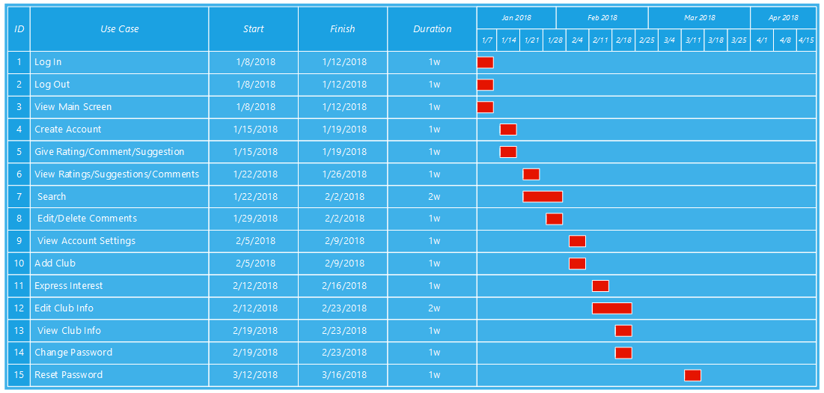
Gantt Chart

Slide 4
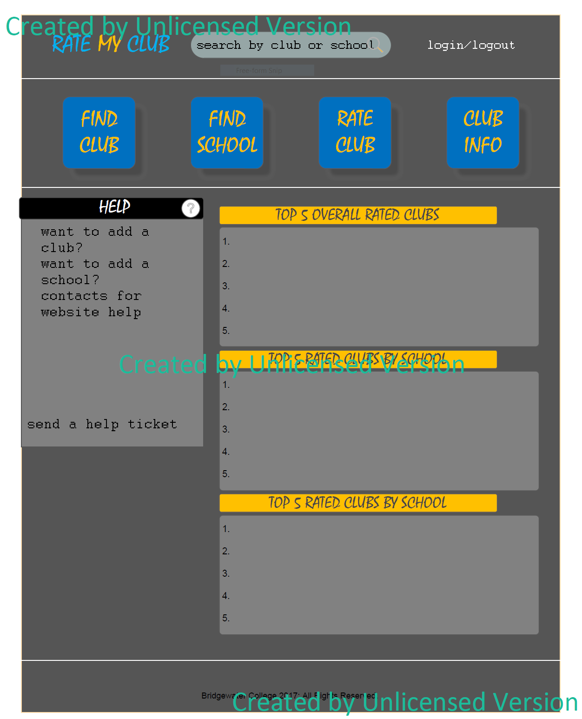
Main Screen Mockup

Slide 5
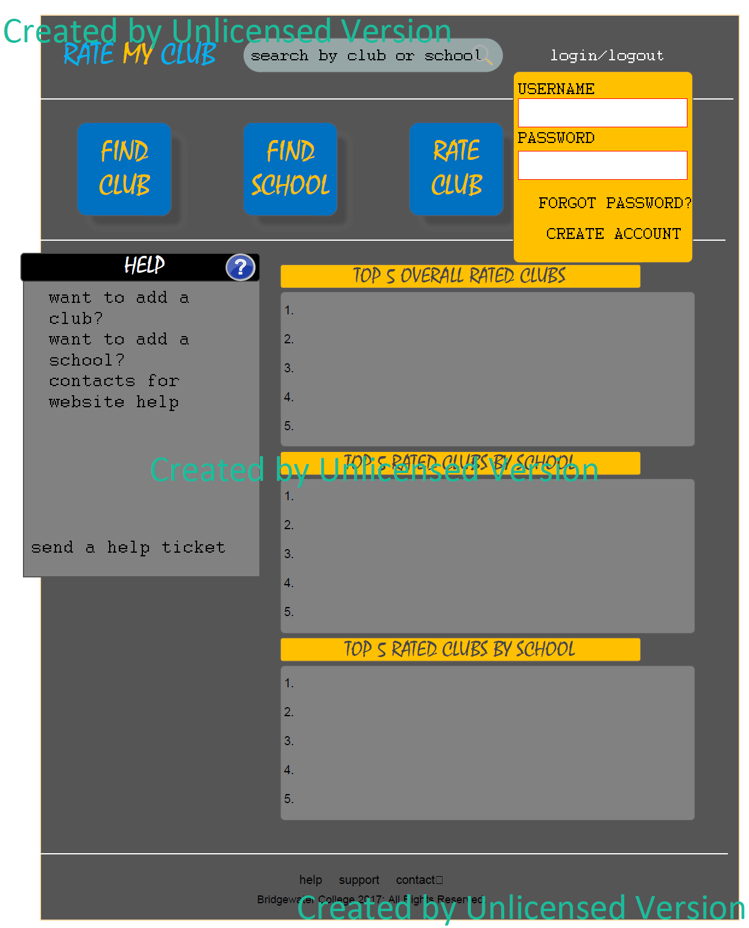
Login Dropdown Mockup

Slide 6
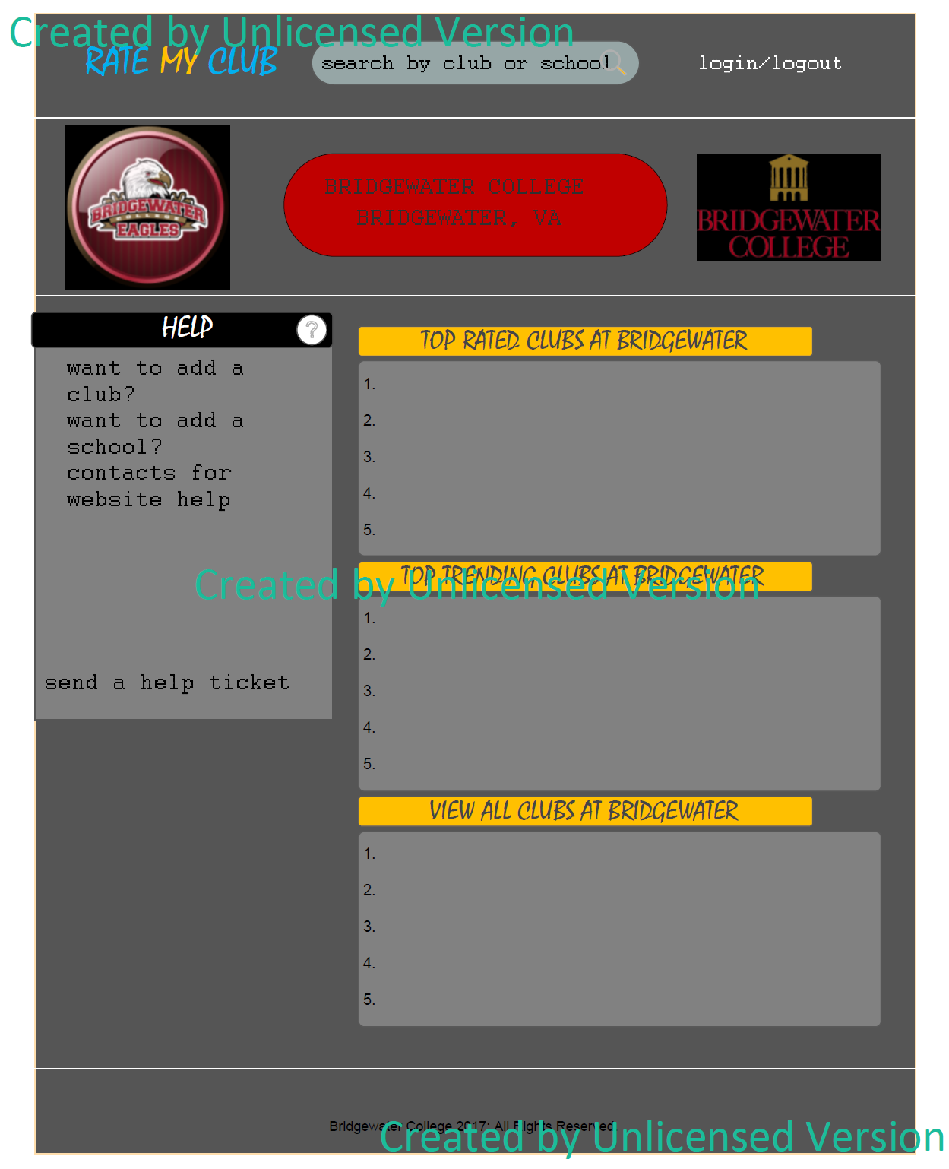
College Page Mockup

Slide 7
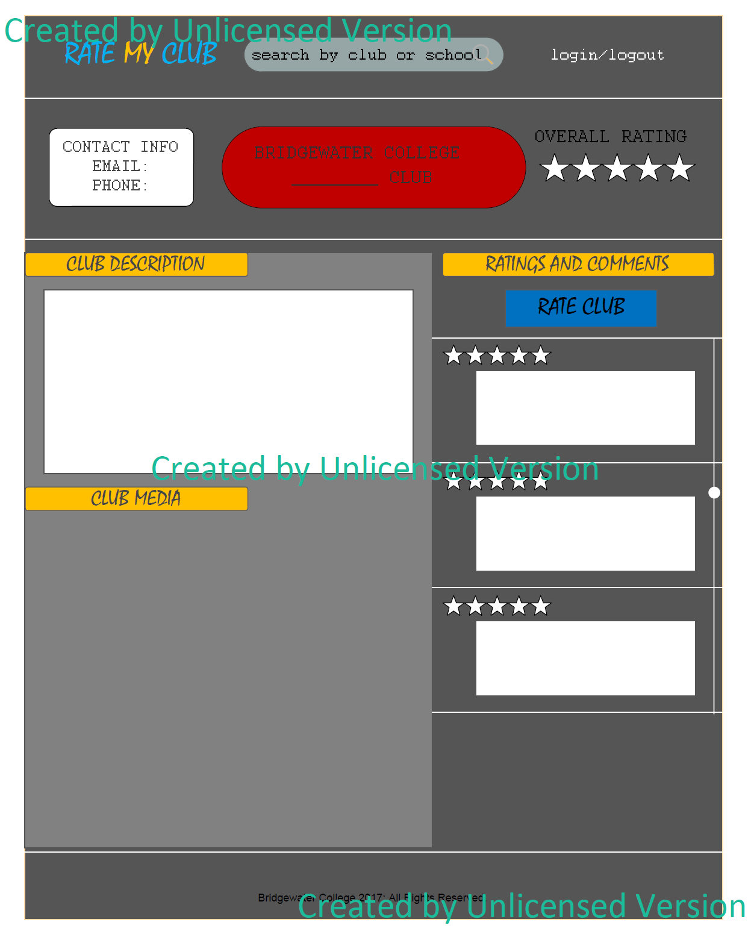
Club Page Mockup

Slide 8
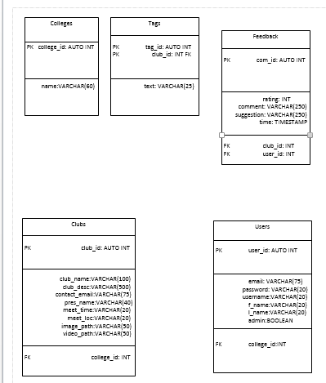
Database Design

Slide 9
Test Case Example
Test Case ID TC001 “View Main Screen” Summary: Verify that the main screen of the website is shown when a user enters the address into their browser. Prerequisite: None Instructions: Perform the following actions. Test Data and Expected Results 1. Enter the website address into a browser. Result: The website should load the main screen.

Slide 10
Functional Requirements
Search - search database for clubs and schools using names or tags
Retrieve - return information from the database and display it
Insert - enter ratings and reviews into the database
Update - replace a previous rating or review from a user with a new entry
Update - admin can replace update information in the club table
Delete - admin can delete entries from the club table

Slide 11
Functional Requirements
Create Account
Delete Account
Log In
Log Out
Rate Club
Change Password
View Account Settings
Edit or View Rating or Review
View Club Information
Express Interest
Admin Only:
Delete Club
Edit Club
Add Club
Delete Comment

Slide 12
Nonfunctional Requirements
Security - password protected accounts with different permissions and password reset
Maintainability - database is automatically refreshed
Usability - application will have error catching to prevent crashes
Email Verification - user accounts will be verified using an automated email
Password Requirements - passwords will be checked to meet certain requirements
Password Verification - new passwords must match each other

